Slide 1
Probing the links between climate change and forest species invasion through genomics
Forest Canopy Genomic Workshop
College of Forestry and Natural Resources, UPLB
Nov. 19, 2016
LERMA SJ. MALDIA
Assistant Professor
Dept. Forest Biological Sciences
College of Forestry and Natural Resources University of the Philippines Los Banos
UPLB | UPLB | UPLB | UPLB | UPLB | UPLB | UPLB | UPLB | UPLB
UPLB | UPLB | UPLB | UPLB | UPLB | UPLB | UPLB | UPLB | UPLB
UPLB | UPLB | UPLB | UPLB | UPLB | UPLB | UPLB | UPLB | UPLB
UPLB | UPLB | UPLB | UPLB | UPLB | UPLB | UPLB | UPLB | UPLB
UPLB | UPLB | UPLB | UPLB | UPLB | UPLB | UPLB | UPLB | UPLB UPLB | UPLB | UPLB | UPLB | UPLB | UPLB | UPLB | UPLB | UPLB
UPLB | UPLB | UPLB | UPLB | UPLB | UPLB | UPLB | UPLB | UPLB
UPLB | UPLB | UPLB | UPLB | UPLB | UPLB | UPLB | UPLB | UPLB
UPLB | UPLB | UPLB | UPLB | UPLB | UPLB | UPLB | UPLB | UPLB
UPLB | UPLB | UPLB | UPLB | UPLB | UPLB | UPLB | UPLB | UPLB

Slide 2
Biological invasion
INVASIVE SPECIES and POPULATIONS pose major threats to biodiversity ecosystem integrity
Impacts include
alterations of ecosystem features such as hydrology, fire regimes, food webs, soil nutrients and nutrient cycling, negative effects on populations;
changes in evolutionary trajectories, such as by hybridization; and
evolutionary shifts in species responding to the new introductions
UPLB | UPLB | UPLB | UPLB | UPLB | UPLB | UPLB | UPLB | UPLB
UPLB | UPLB | UPLB | UPLB | UPLB | UPLB | UPLB | UPLB | UPLB
UPLB | UPLB | UPLB | UPLB | UPLB | UPLB | UPLB | UPLB | UPLB
UPLB | UPLB | UPLB | UPLB | UPLB | UPLB | UPLB | UPLB | UPLB
UPLB | UPLB | UPLB | UPLB | UPLB | UPLB | UPLB | UPLB | UPLB UPLB | UPLB | UPLB | UPLB | UPLB | UPLB | UPLB | UPLB | UPLB
UPLB | UPLB | UPLB | UPLB | UPLB | UPLB | UPLB | UPLB | UPLB
UPLB | UPLB | UPLB | UPLB | UPLB | UPLB | UPLB | UPLB | UPLB
UPLB | UPLB | UPLB | UPLB | UPLB | UPLB | UPLB | UPLB | UPLB
UPLB | UPLB | UPLB | UPLB | UPLB | UPLB | UPLB | UPLB | UPLB
Notes:
Biological invasions present interesting evolutionary problems because they are stochastic events often involving small populations that can survive rapid habitat transitions.

Slide 3
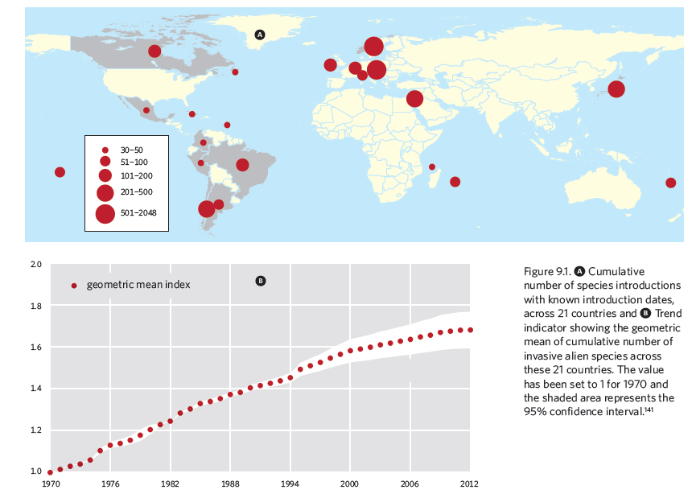
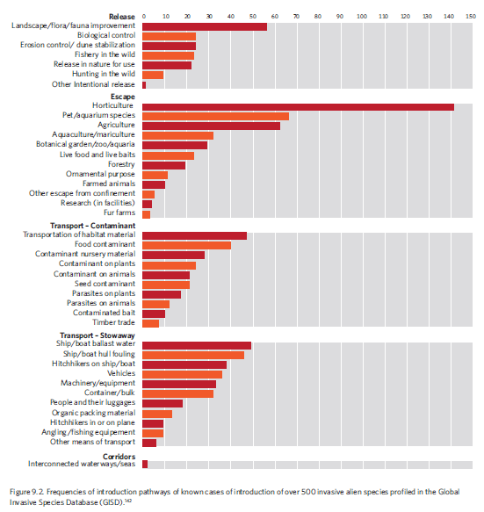
Global threats from invasive alien species
UNCBD global report on species introduction
Releases
Escapees
Transport-contaminant
Stow away
UPLB | UPLB | UPLB | UPLB | UPLB | UPLB | UPLB | UPLB | UPLB
UPLB | UPLB | UPLB | UPLB | UPLB | UPLB | UPLB | UPLB | UPLB
UPLB | UPLB | UPLB | UPLB | UPLB | UPLB | UPLB | UPLB | UPLB
UPLB | UPLB | UPLB | UPLB | UPLB | UPLB | UPLB | UPLB | UPLB
UPLB | UPLB | UPLB | UPLB | UPLB | UPLB | UPLB | UPLB | UPLB UPLB | UPLB | UPLB | UPLB | UPLB | UPLB | UPLB | UPLB | UPLB
UPLB | UPLB | UPLB | UPLB | UPLB | UPLB | UPLB | UPLB | UPLB
UPLB | UPLB | UPLB | UPLB | UPLB | UPLB | UPLB | UPLB | UPLB
UPLB | UPLB | UPLB | UPLB | UPLB | UPLB | UPLB | UPLB | UPLB
UPLB | UPLB | UPLB | UPLB | UPLB | UPLB | UPLB | UPLB | UPLB
Corridors

Slide 4
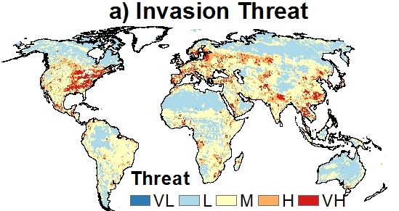
Global biological invasion threat
“VL” is very low; “VH” is very high. Courtesy Ted Grosholz/UC Davis.
The rate of biological invasions is expected to increase as the effects of climate change on biological communities become widespread.
Climate change enhances habitat disturbance, which facilitates the establishment of invasive species
UPLB | UPLB | UPLB | UPLB | UPLB | UPLB | UPLB | UPLB | UPLB
UPLB | UPLB | UPLB | UPLB | UPLB | UPLB | UPLB | UPLB | UPLB
UPLB | UPLB | UPLB | UPLB | UPLB | UPLB | UPLB | UPLB | UPLB
UPLB | UPLB | UPLB | UPLB | UPLB | UPLB | UPLB | UPLB | UPLB
UPLB | UPLB | UPLB | UPLB | UPLB | UPLB | UPLB | UPLB | UPLB UPLB | UPLB | UPLB | UPLB | UPLB | UPLB | UPLB | UPLB | UPLB
UPLB | UPLB | UPLB | UPLB | UPLB | UPLB | UPLB | UPLB | UPLB
UPLB | UPLB | UPLB | UPLB | UPLB | UPLB | UPLB | UPLB | UPLB
UPLB | UPLB | UPLB | UPLB | UPLB | UPLB | UPLB | UPLB | UPLB
UPLB | UPLB | UPLB | UPLB | UPLB | UPLB | UPLB | UPLB | UPLB

Slide 5
Strategic Goal B of the UNCBD (Target by 2020)
Reduce the direct pressures on biodiversity and promote sustainable use
The overall rate of invasions, with great economic and ecological costs, shows no sign of slowing.
Preventive measures have been taken in a limited number of countries.
Notes:
While governments are increasingly taking steps to control and eradicate invasive alien species, the overall…

Slide 6
Global threats from invasive alien species in the 21st Century
Most countries lack measures to prevent introduction or monitor invasive spread
UPLB | UPLB | UPLB | UPLB | UPLB | UPLB | UPLB | UPLB | UPLB
UPLB | UPLB | UPLB | UPLB | UPLB | UPLB | UPLB | UPLB | UPLB
UPLB | UPLB | UPLB | UPLB | UPLB | UPLB | UPLB | UPLB | UPLB
UPLB | UPLB | UPLB | UPLB | UPLB | UPLB | UPLB | UPLB | UPLB
UPLB | UPLB | UPLB | UPLB | UPLB | UPLB | UPLB | UPLB | UPLB UPLB | UPLB | UPLB | UPLB | UPLB | UPLB | UPLB | UPLB | UPLB
UPLB | UPLB | UPLB | UPLB | UPLB | UPLB | UPLB | UPLB | UPLB
UPLB | UPLB | UPLB | UPLB | UPLB | UPLB | UPLB | UPLB | UPLB
UPLB | UPLB | UPLB | UPLB | UPLB | UPLB | UPLB | UPLB | UPLB
UPLB | UPLB | UPLB | UPLB | UPLB | UPLB | UPLB | UPLB | UPLB
Notes:
Most countries lack measures to prevent introduction or monitor invasive spread

Slide 7
Forest Canopy Genomics
Genomics is a growing field that combines DNA sequencing and bioinformatics to assemble and analyze the function and structure of genomes
Emerging research areas
Utilize genomics to identify species vulnerability to climate change and understand forest genomics and its relationships to ecosystem resilience, recovery, and vulnerability to climate change
UPLB | UPLB | UPLB | UPLB | UPLB | UPLB | UPLB | UPLB | UPLB
UPLB | UPLB | UPLB | UPLB | UPLB | UPLB | UPLB | UPLB | UPLB
UPLB | UPLB | UPLB | UPLB | UPLB | UPLB | UPLB | UPLB | UPLB
UPLB | UPLB | UPLB | UPLB | UPLB | UPLB | UPLB | UPLB | UPLB
UPLB | UPLB | UPLB | UPLB | UPLB | UPLB | UPLB | UPLB | UPLB UPLB | UPLB | UPLB | UPLB | UPLB | UPLB | UPLB | UPLB | UPLB
UPLB | UPLB | UPLB | UPLB | UPLB | UPLB | UPLB | UPLB | UPLB
UPLB | UPLB | UPLB | UPLB | UPLB | UPLB | UPLB | UPLB | UPLB
UPLB | UPLB | UPLB | UPLB | UPLB | UPLB | UPLB | UPLB | UPLB
UPLB | UPLB | UPLB | UPLB | UPLB | UPLB | UPLB | UPLB | UPLB

Slide 8
Research in Forest Genomics, Invasion, and Climate Change
Major evolutionary and demographic events such as colonization, population growth, and local adaptation in response to climate changes are recorded in the genomes of species.
How species responded to historical climate change?
Study on impact of post-glacial warming on genomic diversity and physiological adaptation across the landscape
Study on the genomic regions associated with adaptation to local climate conditions, especially in ecologically and economically important species such as forest trees
UPLB | UPLB | UPLB | UPLB | UPLB | UPLB | UPLB | UPLB | UPLB
UPLB | UPLB | UPLB | UPLB | UPLB | UPLB | UPLB | UPLB | UPLB
UPLB | UPLB | UPLB | UPLB | UPLB | UPLB | UPLB | UPLB | UPLB
UPLB | UPLB | UPLB | UPLB | UPLB | UPLB | UPLB | UPLB | UPLB
UPLB | UPLB | UPLB | UPLB | UPLB | UPLB | UPLB | UPLB | UPLB UPLB | UPLB | UPLB | UPLB | UPLB | UPLB | UPLB | UPLB | UPLB
UPLB | UPLB | UPLB | UPLB | UPLB | UPLB | UPLB | UPLB | UPLB
UPLB | UPLB | UPLB | UPLB | UPLB | UPLB | UPLB | UPLB | UPLB
UPLB | UPLB | UPLB | UPLB | UPLB | UPLB | UPLB | UPLB | UPLB
UPLB | UPLB | UPLB | UPLB | UPLB | UPLB | UPLB | UPLB | UPLB
Notes:
After the end of the Pleistocene ice age (~20 kya), changing climate conditions caused many species to expand their ranges out of refugial areas to re-colonize the vast continental land masses left vacant by retreating glaciers.

Slide 9
Changes in environmental conditions can affect species abundance and distribution
UPLB | UPLB | UPLB | UPLB | UPLB | UPLB | UPLB | UPLB | UPLB
UPLB | UPLB | UPLB | UPLB | UPLB | UPLB | UPLB | UPLB | UPLB
UPLB | UPLB | UPLB | UPLB | UPLB | UPLB | UPLB | UPLB | UPLB
UPLB | UPLB | UPLB | UPLB | UPLB | UPLB | UPLB | UPLB | UPLB
UPLB | UPLB | UPLB | UPLB | UPLB | UPLB | UPLB | UPLB | UPLB UPLB | UPLB | UPLB | UPLB | UPLB | UPLB | UPLB | UPLB | UPLB
UPLB | UPLB | UPLB | UPLB | UPLB | UPLB | UPLB | UPLB | UPLB
UPLB | UPLB | UPLB | UPLB | UPLB | UPLB | UPLB | UPLB | UPLB
UPLB | UPLB | UPLB | UPLB | UPLB | UPLB | UPLB | UPLB | UPLB
UPLB | UPLB | UPLB | UPLB | UPLB | UPLB | UPLB | UPLB | UPLB

Slide 10
Predicting future species distribution based on response of species to environmental changes
No favorable environment may be geographically close enough
Favorable environment may be already occupied by other successful species
Change may be rapid that species has no time to migrate and adapt
UPLB | UPLB | UPLB | UPLB | UPLB | UPLB | UPLB | UPLB | UPLB
UPLB | UPLB | UPLB | UPLB | UPLB | UPLB | UPLB | UPLB | UPLB
UPLB | UPLB | UPLB | UPLB | UPLB | UPLB | UPLB | UPLB | UPLB
UPLB | UPLB | UPLB | UPLB | UPLB | UPLB | UPLB | UPLB | UPLB
UPLB | UPLB | UPLB | UPLB | UPLB | UPLB | UPLB | UPLB | UPLB UPLB | UPLB | UPLB | UPLB | UPLB | UPLB | UPLB | UPLB | UPLB
UPLB | UPLB | UPLB | UPLB | UPLB | UPLB | UPLB | UPLB | UPLB
UPLB | UPLB | UPLB | UPLB | UPLB | UPLB | UPLB | UPLB | UPLB
UPLB | UPLB | UPLB | UPLB | UPLB | UPLB | UPLB | UPLB | UPLB
UPLB | UPLB | UPLB | UPLB | UPLB | UPLB | UPLB | UPLB | UPLB

Slide 11
Research directions in
Forest Genomics to probe links between climate change and forest species invasion
Genetics of invasive alien forest species
(plants, insects and pathogens)
Tracking introduction routes of IAFS
Understanding mechanisms of spread and adaptation of IAFS (gene-trait association, gene expression, gene-climate adaptation interaction)
UPLB | UPLB | UPLB | UPLB | UPLB | UPLB | UPLB | UPLB | UPLB
UPLB | UPLB | UPLB | UPLB | UPLB | UPLB | UPLB | UPLB | UPLB
UPLB | UPLB | UPLB | UPLB | UPLB | UPLB | UPLB | UPLB | UPLB
UPLB | UPLB | UPLB | UPLB | UPLB | UPLB | UPLB | UPLB | UPLB
UPLB | UPLB | UPLB | UPLB | UPLB | UPLB | UPLB | UPLB | UPLB UPLB | UPLB | UPLB | UPLB | UPLB | UPLB | UPLB | UPLB | UPLB
UPLB | UPLB | UPLB | UPLB | UPLB | UPLB | UPLB | UPLB | UPLB
UPLB | UPLB | UPLB | UPLB | UPLB | UPLB | UPLB | UPLB | UPLB
UPLB | UPLB | UPLB | UPLB | UPLB | UPLB | UPLB | UPLB | UPLB
UPLB | UPLB | UPLB | UPLB | UPLB | UPLB | UPLB | UPLB | UPLB
Notes:
To assist in developing effective strategies for preventing and managing invasive species and for predicting responses of populations to various control measures (biological or chemical)

Slide 12
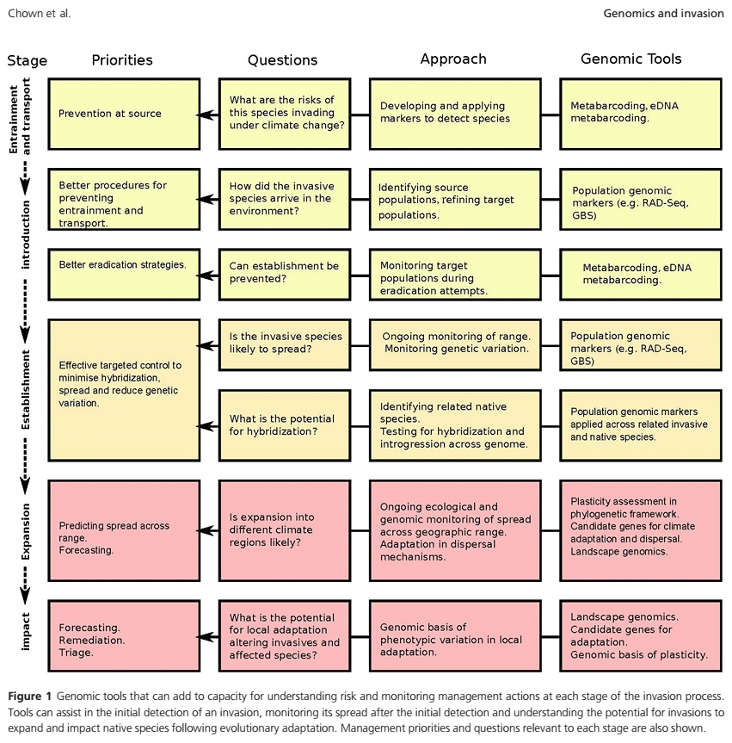
Opportunities/Potentials to realize research directions in genomic-climate change-invasion-relationships
Available massive range-wide genomic sampling, Available cutting edge genomic analysis,
Available fine-scale microclimatic sampling ,
Available powerful simulation modeling
→ Can revolutionize understanding gene-environment-climate interactions (in species or population) and how they influence ecosystem responses to global change
UPLB | UPLB | UPLB | UPLB | UPLB | UPLB | UPLB | UPLB | UPLB
UPLB | UPLB | UPLB | UPLB | UPLB | UPLB | UPLB | UPLB | UPLB
UPLB | UPLB | UPLB | UPLB | UPLB | UPLB | UPLB | UPLB | UPLB
UPLB | UPLB | UPLB | UPLB | UPLB | UPLB | UPLB | UPLB | UPLB
UPLB | UPLB | UPLB | UPLB | UPLB | UPLB | UPLB | UPLB | UPLB UPLB | UPLB | UPLB | UPLB | UPLB | UPLB | UPLB | UPLB | UPLB
UPLB | UPLB | UPLB | UPLB | UPLB | UPLB | UPLB | UPLB | UPLB
UPLB | UPLB | UPLB | UPLB | UPLB | UPLB | UPLB | UPLB | UPLB
UPLB | UPLB | UPLB | UPLB | UPLB | UPLB | UPLB | UPLB | UPLB
UPLB | UPLB | UPLB | UPLB | UPLB | UPLB | UPLB | UPLB | UPLB
Genomic tools that can add capacity for understanding risk and monitoring management actions at each stage of invasion

Slide 13
What are the risks of this species invading under climate change?
Opportunities/Potentials to realize research directions in genomic-climate change-invasion-relationships
Available massive range-wide genomic sampling, Available cutting edge genomic analysis,
Available fine-scale microclimatic sampling ,
Available powerful simulation modeling
→ Can revolutionize understanding gene-environment-climate interactions (in species or population) and how they influence ecosystem responses to global change
UPLB | UPLB | UPLB | UPLB | UPLB | UPLB | UPLB | UPLB | UPLB
UPLB | UPLB | UPLB | UPLB | UPLB | UPLB | UPLB | UPLB | UPLB
UPLB | UPLB | UPLB | UPLB | UPLB | UPLB | UPLB | UPLB | UPLB
UPLB | UPLB | UPLB | UPLB | UPLB | UPLB | UPLB | UPLB | UPLB
UPLB | UPLB | UPLB | UPLB | UPLB | UPLB | UPLB | UPLB | UPLB UPLB | UPLB | UPLB | UPLB | UPLB | UPLB | UPLB | UPLB | UPLB
UPLB | UPLB | UPLB | UPLB | UPLB | UPLB | UPLB | UPLB | UPLB
UPLB | UPLB | UPLB | UPLB | UPLB | UPLB | UPLB | UPLB | UPLB
UPLB | UPLB | UPLB | UPLB | UPLB | UPLB | UPLB | UPLB | UPLB
UPLB | UPLB | UPLB | UPLB | UPLB | UPLB | UPLB | UPLB | UPLB
Genomic tools that can add capacity for understanding risk and monitoring management actions at each stage of invasion

Slide 14
Opportunities/Potentials to realize research directions in genomic-climate change-invasion-relationships
Available massive range-wide genomic sampling, Available cutting edge genomic analysis,
Available fine-scale microclimatic sampling ,
Available powerful simulation modeling
→ Can revolutionize understanding gene-environment-climate interactions (in species or population) and how they influence ecosystem responses to global change
Is the invasive species likely to spread?
UPLB | UPLB | UPLB | UPLB | UPLB | UPLB | UPLB | UPLB | UPLB
UPLB | UPLB | UPLB | UPLB | UPLB | UPLB | UPLB | UPLB | UPLB
UPLB | UPLB | UPLB | UPLB | UPLB | UPLB | UPLB | UPLB | UPLB
UPLB | UPLB | UPLB | UPLB | UPLB | UPLB | UPLB | UPLB | UPLB
UPLB | UPLB | UPLB | UPLB | UPLB | UPLB | UPLB | UPLB | UPLB UPLB | UPLB | UPLB | UPLB | UPLB | UPLB | UPLB | UPLB | UPLB
UPLB | UPLB | UPLB | UPLB | UPLB | UPLB | UPLB | UPLB | UPLB
UPLB | UPLB | UPLB | UPLB | UPLB | UPLB | UPLB | UPLB | UPLB
UPLB | UPLB | UPLB | UPLB | UPLB | UPLB | UPLB | UPLB | UPLB
UPLB | UPLB | UPLB | UPLB | UPLB | UPLB | UPLB | UPLB | UPLB
Genomic tools that can add capacity for understanding risk and monitoring management actions at each stage of invasion

Slide 15
Opportunities/Potentials to realize research directions in genomic-climate change-invasion-relationships
Available massive range-wide genomic sampling, Available cutting edge genomic analysis,
Available fine-scale microclimatic sampling ,
Available powerful simulation modeling
→ Can revolutionize understanding gene-environment-climate interactions (in species or population) and how they influence ecosystem responses to global change
Is expansion into different climate regions likely?
UPLB | UPLB | UPLB | UPLB | UPLB | UPLB | UPLB | UPLB | UPLB
UPLB | UPLB | UPLB | UPLB | UPLB | UPLB | UPLB | UPLB | UPLB
UPLB | UPLB | UPLB | UPLB | UPLB | UPLB | UPLB | UPLB | UPLB
UPLB | UPLB | UPLB | UPLB | UPLB | UPLB | UPLB | UPLB | UPLB
UPLB | UPLB | UPLB | UPLB | UPLB | UPLB | UPLB | UPLB | UPLB UPLB | UPLB | UPLB | UPLB | UPLB | UPLB | UPLB | UPLB | UPLB
UPLB | UPLB | UPLB | UPLB | UPLB | UPLB | UPLB | UPLB | UPLB
UPLB | UPLB | UPLB | UPLB | UPLB | UPLB | UPLB | UPLB | UPLB
UPLB | UPLB | UPLB | UPLB | UPLB | UPLB | UPLB | UPLB | UPLB
UPLB | UPLB | UPLB | UPLB | UPLB | UPLB | UPLB | UPLB | UPLB
Genomic tools that can add capacity for understanding risk and monitoring management actions at each stage of invasion

Slide 16
Opportunities/Potentials to realize research directions in genomic-climate change-invasion-relationships
Available massive range-wide genomic sampling, Available cutting edge genomic analysis,
Available fine-scale microclimatic sampling ,
Available powerful simulation modeling
→ Can revolutionize understanding gene-environment-climate interactions (in species or population) and how they influence ecosystem responses to global change
What is the potential for local adaptation altering invasives and affected species
Is expansion into different climate regions likely?
UPLB | UPLB | UPLB | UPLB | UPLB | UPLB | UPLB | UPLB | UPLB
UPLB | UPLB | UPLB | UPLB | UPLB | UPLB | UPLB | UPLB | UPLB
UPLB | UPLB | UPLB | UPLB | UPLB | UPLB | UPLB | UPLB | UPLB
UPLB | UPLB | UPLB | UPLB | UPLB | UPLB | UPLB | UPLB | UPLB
UPLB | UPLB | UPLB | UPLB | UPLB | UPLB | UPLB | UPLB | UPLB UPLB | UPLB | UPLB | UPLB | UPLB | UPLB | UPLB | UPLB | UPLB
UPLB | UPLB | UPLB | UPLB | UPLB | UPLB | UPLB | UPLB | UPLB
UPLB | UPLB | UPLB | UPLB | UPLB | UPLB | UPLB | UPLB | UPLB
UPLB | UPLB | UPLB | UPLB | UPLB | UPLB | UPLB | UPLB | UPLB
UPLB | UPLB | UPLB | UPLB | UPLB | UPLB | UPLB | UPLB | UPLB
Genomic tools that can add capacity for understanding risk and monitoring management actions at each stage of invasion

Slide 17
Research in Forest Genomics, Invasion, and Climate Change
invasion success was influenced by genetic architecture within source populations; and
natural selection on this genetic substrate has led to rapid adaptations in the new environments
Epistatic interactions could contribute to adaptation during invasions; and
Small numbers of genes could have profound effects on invasion success
UPLB | UPLB | UPLB | UPLB | UPLB | UPLB | UPLB | UPLB | UPLB
UPLB | UPLB | UPLB | UPLB | UPLB | UPLB | UPLB | UPLB | UPLB
UPLB | UPLB | UPLB | UPLB | UPLB | UPLB | UPLB | UPLB | UPLB
UPLB | UPLB | UPLB | UPLB | UPLB | UPLB | UPLB | UPLB | UPLB
UPLB | UPLB | UPLB | UPLB | UPLB | UPLB | UPLB | UPLB | UPLB UPLB | UPLB | UPLB | UPLB | UPLB | UPLB | UPLB | UPLB | UPLB
UPLB | UPLB | UPLB | UPLB | UPLB | UPLB | UPLB | UPLB | UPLB
UPLB | UPLB | UPLB | UPLB | UPLB | UPLB | UPLB | UPLB | UPLB
UPLB | UPLB | UPLB | UPLB | UPLB | UPLB | UPLB | UPLB | UPLB
UPLB | UPLB | UPLB | UPLB | UPLB | UPLB | UPLB | UPLB | UPLB

Slide 18
Opportunities/Potentials to realize research directions in genomics on climate change-invasion-relationships
Available massive range-wide genomic sampling, Available cutting edge genomic analysis,
Available fine-scale microclimatic sampling ,
Available powerful simulation modeling
→ Can revolutionize understanding gene-environment-climate interactions (in species or population) and how they influence ecosystem responses to global change
UPLB | UPLB | UPLB | UPLB | UPLB | UPLB | UPLB | UPLB | UPLB
UPLB | UPLB | UPLB | UPLB | UPLB | UPLB | UPLB | UPLB | UPLB
UPLB | UPLB | UPLB | UPLB | UPLB | UPLB | UPLB | UPLB | UPLB
UPLB | UPLB | UPLB | UPLB | UPLB | UPLB | UPLB | UPLB | UPLB
UPLB | UPLB | UPLB | UPLB | UPLB | UPLB | UPLB | UPLB | UPLB UPLB | UPLB | UPLB | UPLB | UPLB | UPLB | UPLB | UPLB | UPLB
UPLB | UPLB | UPLB | UPLB | UPLB | UPLB | UPLB | UPLB | UPLB
UPLB | UPLB | UPLB | UPLB | UPLB | UPLB | UPLB | UPLB | UPLB
UPLB | UPLB | UPLB | UPLB | UPLB | UPLB | UPLB | UPLB | UPLB
UPLB | UPLB | UPLB | UPLB | UPLB | UPLB | UPLB | UPLB | UPLB
Notes:
To assist in developing effective strategies for preventing and managing invasive species and for predicting responses of populations to various control measures (biological or chemical)

Slide 19
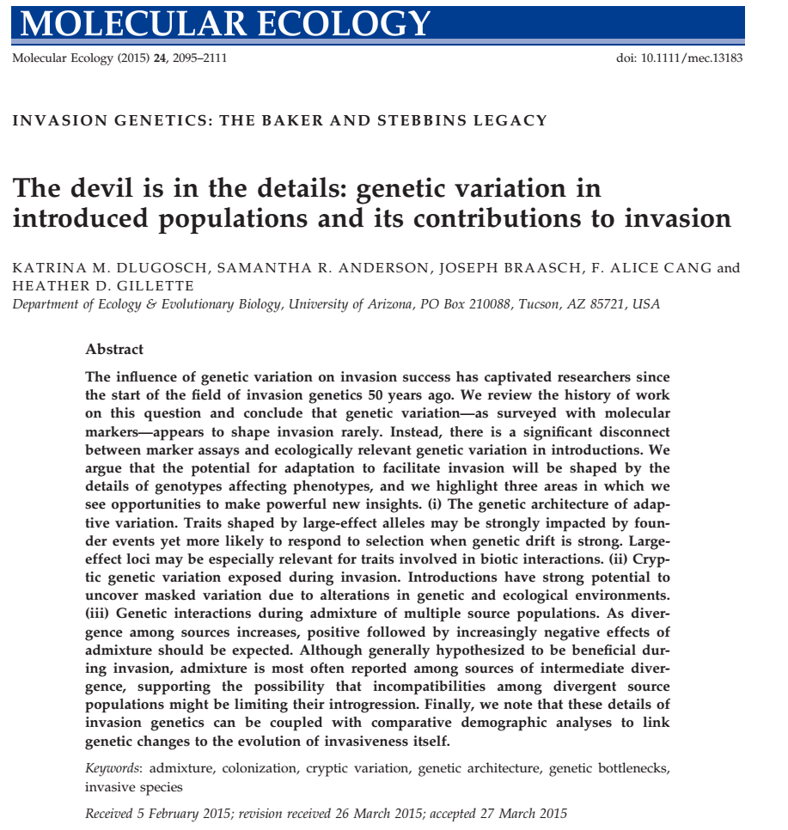
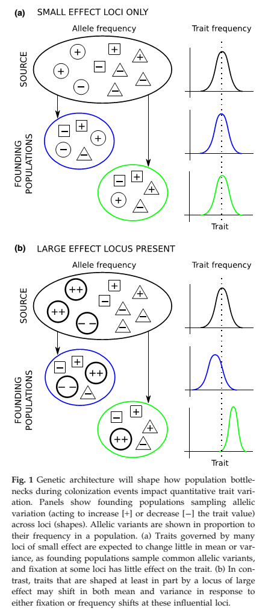
Genetic architecture shapes how population bottlenecks during colonization impacts quantitative trait variation

Slide 20
Research in Forest Genomics, Invasion, and Climate Change
These intriguing results emphasize the utility of exploring genomic characteristics of invasive species, such as genes, gene complexes, and epistatic interactions that promote invasive behavior.
Such information could yield insights into the relationship between genetic architecture and rate of evolution, and evolutionary versus ecological factors, which confer invasion success.
→ key to understanding and managing forest responses to current climate change
UPLB | UPLB | UPLB | UPLB | UPLB | UPLB | UPLB | UPLB | UPLB
UPLB | UPLB | UPLB | UPLB | UPLB | UPLB | UPLB | UPLB | UPLB
UPLB | UPLB | UPLB | UPLB | UPLB | UPLB | UPLB | UPLB | UPLB
UPLB | UPLB | UPLB | UPLB | UPLB | UPLB | UPLB | UPLB | UPLB
UPLB | UPLB | UPLB | UPLB | UPLB | UPLB | UPLB | UPLB | UPLB UPLB | UPLB | UPLB | UPLB | UPLB | UPLB | UPLB | UPLB | UPLB
UPLB | UPLB | UPLB | UPLB | UPLB | UPLB | UPLB | UPLB | UPLB
UPLB | UPLB | UPLB | UPLB | UPLB | UPLB | UPLB | UPLB | UPLB
UPLB | UPLB | UPLB | UPLB | UPLB | UPLB | UPLB | UPLB | UPLB
UPLB | UPLB | UPLB | UPLB | UPLB | UPLB | UPLB | UPLB | UPLB

Slide 21
Research in Forest Genomics, Invasion, and Climate Change
Integration of tools from genomics, remote sensing, and geospatial modeling to study the genetic basis of climate adaptation, e.g. of forest trees
Genome-wide SNP data are generated using Genotype by Sequencing (GBS) to genome scans for local adaptation and association mapping for phenology, growth, and water use efficiency traits
Developing spatial analytical methods to characterize the associations between genomic variation and environmental gradients of climate and growing season length, and to visualize the landscape surface of adaptive variation under both current and projected climates.
UPLB | UPLB | UPLB | UPLB | UPLB | UPLB | UPLB | UPLB | UPLB
UPLB | UPLB | UPLB | UPLB | UPLB | UPLB | UPLB | UPLB | UPLB
UPLB | UPLB | UPLB | UPLB | UPLB | UPLB | UPLB | UPLB | UPLB
UPLB | UPLB | UPLB | UPLB | UPLB | UPLB | UPLB | UPLB | UPLB
UPLB | UPLB | UPLB | UPLB | UPLB | UPLB | UPLB | UPLB | UPLB UPLB | UPLB | UPLB | UPLB | UPLB | UPLB | UPLB | UPLB | UPLB
UPLB | UPLB | UPLB | UPLB | UPLB | UPLB | UPLB | UPLB | UPLB
UPLB | UPLB | UPLB | UPLB | UPLB | UPLB | UPLB | UPLB | UPLB
UPLB | UPLB | UPLB | UPLB | UPLB | UPLB | UPLB | UPLB | UPLB
UPLB | UPLB | UPLB | UPLB | UPLB | UPLB | UPLB | UPLB | UPLB
Notes:
Genome-wide single nucleotide polymorphism (SNP) data are being generated using Genotype by Sequencing (GBS) technology for hundreds of poplar genotypes and used to perform genome scans for local adaptation and association mapping for phenology, growth, and water use efficiency traits. Regions of the genome associated with climate adaptation will be used to predict field performance using an independent sample of genotypes and an innovative remote sensing approach to measure phenology. We are also developing new spatial analytical methods to characterize the associations between genomic variation and environmental gradients of climate and growing season length, and to visualize the landscape surface of adaptive variation under both current and projected climates.

Slide 22
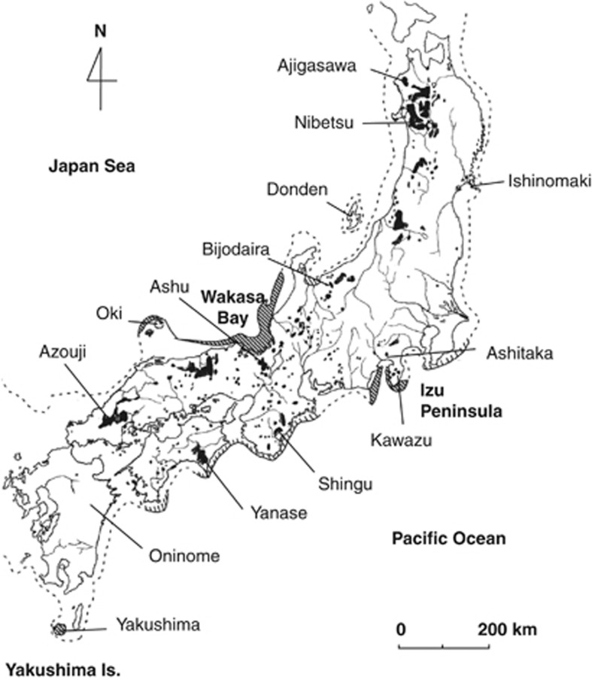
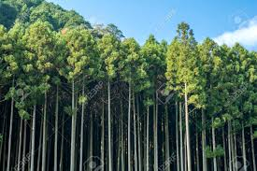
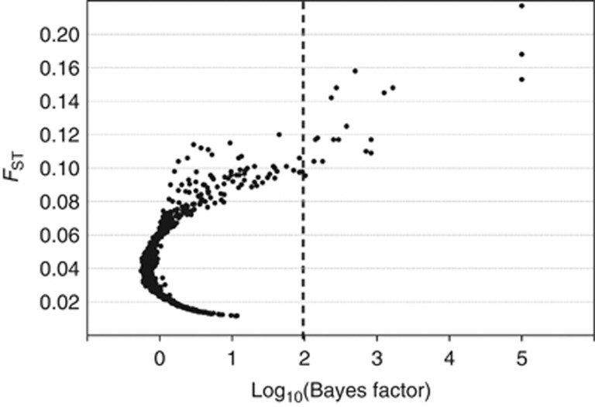
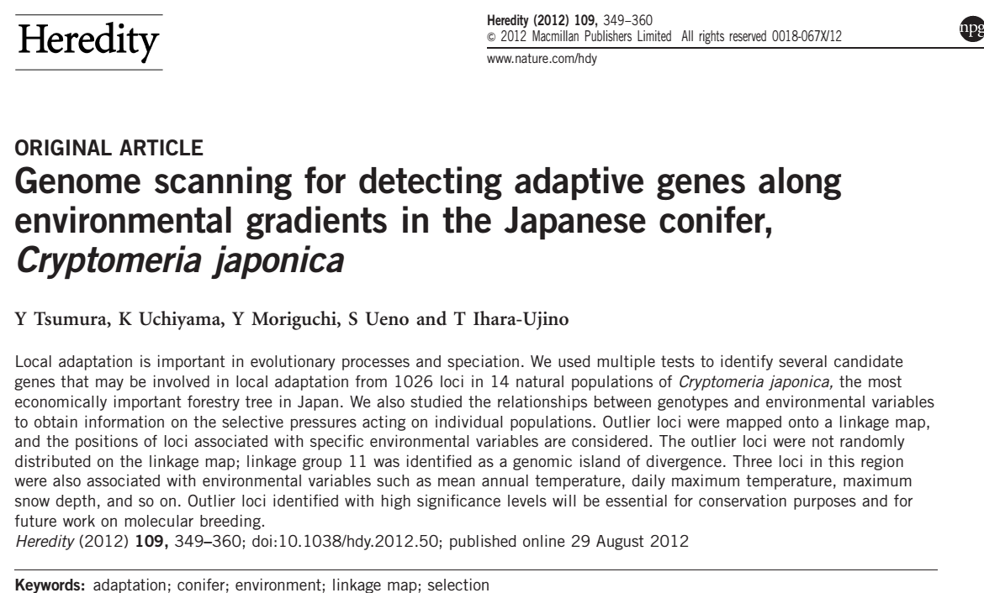
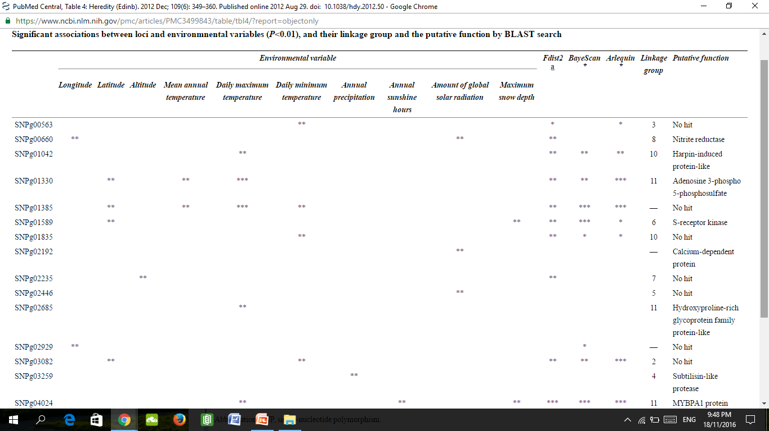
Cryptomeria japonica (Japanese cedar)
Loci under selection
Significant association between loci and environmental variables

Slide 23
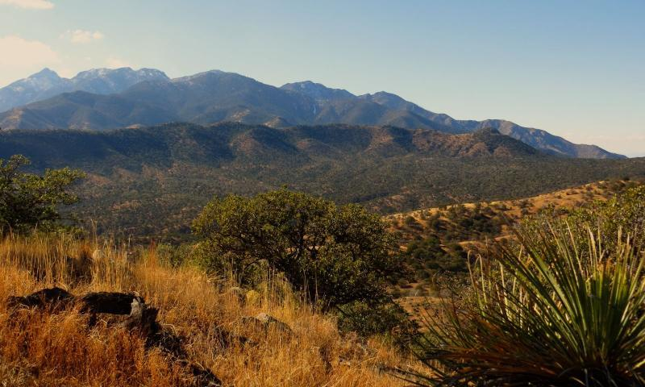
Research in Forest Genomics and climate change
Understanding tree genomics and its relationships with climate change and disturbance regimes promises to revolutionize management and conservation of natural resources.
Ecosystem resistance, resilience, and recovery are closely linked to the population responses of tree species to perturbations such as climate change and disturbance. The genomics of tree populations largely govern their ability to resist or recover from such impacts.
The Santa Rita Mountains in Arizona, a Madrean Sky Island range
Trees vulnerable to climate change; cottonwood (riparian vulnerable to loss of surface water), SW white pine (upper montane sp. (vulnerable to shrinlage and isolation), Douglas Fir (economic and ecological importance and inhabits large range in W USA)
UPLB | UPLB | UPLB | UPLB | UPLB | UPLB | UPLB | UPLB | UPLB
UPLB | UPLB | UPLB | UPLB | UPLB | UPLB | UPLB | UPLB | UPLB
UPLB | UPLB | UPLB | UPLB | UPLB | UPLB | UPLB | UPLB | UPLB
UPLB | UPLB | UPLB | UPLB | UPLB | UPLB | UPLB | UPLB | UPLB
UPLB | UPLB | UPLB | UPLB | UPLB | UPLB | UPLB | UPLB | UPLB UPLB | UPLB | UPLB | UPLB | UPLB | UPLB | UPLB | UPLB | UPLB
UPLB | UPLB | UPLB | UPLB | UPLB | UPLB | UPLB | UPLB | UPLB
UPLB | UPLB | UPLB | UPLB | UPLB | UPLB | UPLB | UPLB | UPLB
UPLB | UPLB | UPLB | UPLB | UPLB | UPLB | UPLB | UPLB | UPLB
UPLB | UPLB | UPLB | UPLB | UPLB | UPLB | UPLB | UPLB | UPLB
Facilitate prediction of effects of climate change on keystone species
Notes:
The projects focus on several focal tree species, including Southwestern white pine, Fremont cottonwood, and Douglas fir across their ranges within the United States. These species were chosen because they represent three highly distinct types of trees that are vulnerable in different ways to climate change.
Fremont cottonwood is a riparian species that is vulnerable to loss of surface water through increased evaporation, decreased precipitation, and increased human utilization of water resources in the southwest
Southwestern white pine is a an upper montane species, and is vulnerable to the shrinkage and isolation of these mountain habitats as the climate warms
Douglas fir is a species of immense economic and ecological importance and inhabits a large range in the western United States.

