Slide 1

Jessa P. Ata
Department of Forest Biological Sciences
College of Forestry and Natural Resources,
University of the Philippines Los Baños
🌳
🍄
Forest Canopy Genomics Workshop | 19 November 2016 | Makiling Botanic Gardens, UPLB
Notes:
forest pathology perspective… Focusing on interaction of fungal pathogens with forest trees;

Slide 2
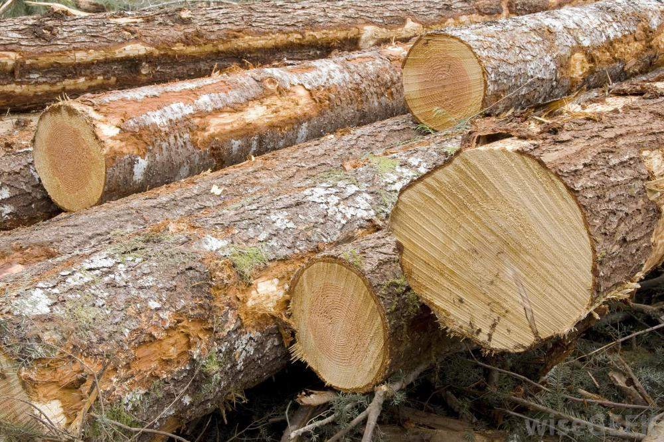
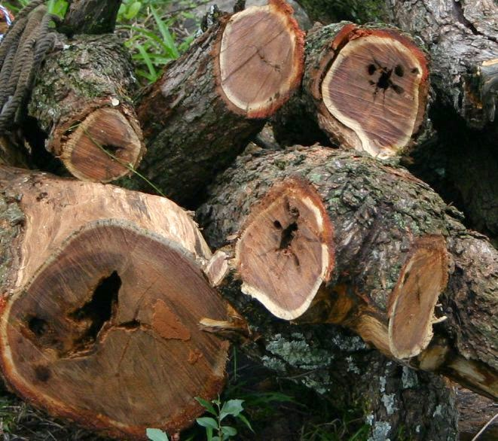
Importance of Forest Trees
🌳
🍄
Demand for wood is expected to continue in the foreseeable future.
Pests and diseases as major threats
Improve our understanding of tree defense response mechanisms against forest pathogens.
Notes:
And what better way to combat these diseases than improving our understanding….
This would also open up new challenges for forest biotechnology, particularly in tree health protection.

Slide 3



Strategies
🌳
🍄
Adoption of omics technologies has marked a new era in forest pathology.
Advances in genome-based studies on plant-associated microorganisms to understand many plant pathogens and plant interactions with mutualistic and commensal microorganisms.
Pathogenomics, culture-independent community profiling methods, metagenomic, metatranscriptomic studies
Notes:
Omics technologies form a powerful tool- box to investigate the intrinsic interactions between forest trees and pathogenic, symbiotic, and endophytic microorganisms.
Together, these approaches have the potential to bridge the gap between plant microbial ecology and plant pathology, which have traditionally been two distinct research fields.
Pathogenomics has revealed how pathogenic microorganisms adapt to particular hosts, subvert innate immune responses and change host range, as well as how new pathogen species emerge. Similarly, culture-independent community profiling methods, coupled with metagenomic and metatranscriptomic studies, have provided the first insights into the emerging field of research on plant-associated microbial communities.

Slide 4
Tree Defenses
🌳
🍄
Preformed Physico-chemical Barriers
  lignin as a major factor retarding litter and wood decomposition in nature
Chemical Defense
  phenolic compounds, terpenoids, and alkaloids
Pathogenesis-related proteins
  rapid host protection with low energy expense
  PR-proteins in Populus trichocarpa provides the only insight on the organization of resistance and defense genes in forest trees at the genome scale
Receptor Proteins in Tree Immunity
  recognition of pathogen-associated molecular patterns to trigger early reactions of plant immune response
Notes:
PR proteins of Poplars served as model to give insights….

Slide 5

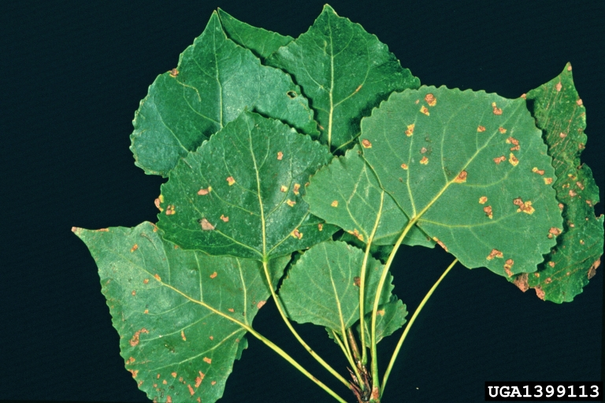
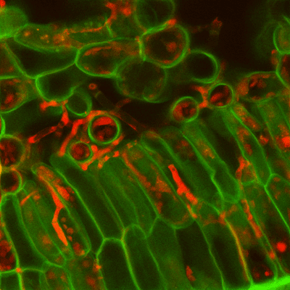
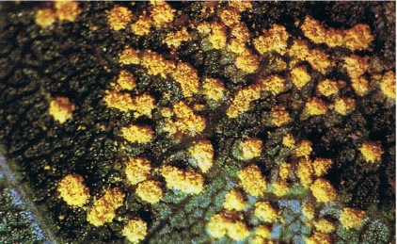
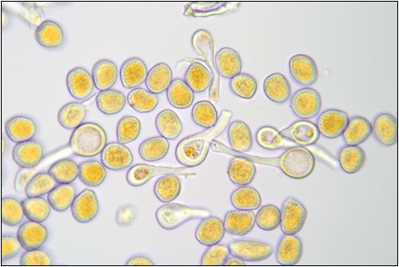
Gene for Resistance
🌳
🍄
Plant disease resistance (R) genes are abundant in every plant species and are characterized by a gene-for-gene interaction.
In trees, R genes were identified in Populus trichocarpa, Eucalyptus grandis, Pinus taeda, Pinus lambertiana, and hybrid poplar.
R gene from Poplar and their hybrids during the interaction with the leaf rust pathogen Melampsora medusa.
Notes:
These tree defense mechanisms come from the genes for resistance.
The first report of R gene from tree species was from poplar and their hybrids identified during the interaction with the leaf rust pathogen Melampsora medusa. The release of genome sequence of P. trichocarpa has enabled the identification of R genes and resistant gene analog (RGAs) clusters and allowed a comparative analysis of these gene families with the herbaceous counterparts like Arabidopsis and rice.

Slide 7
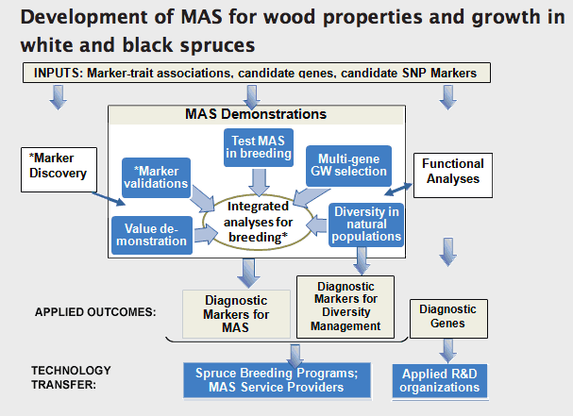
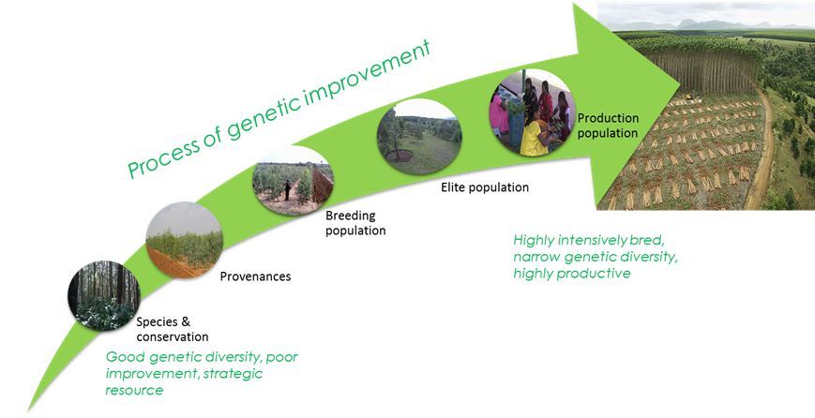
Breeding for Resistance
🌳
🍄
Conventional seed orchard and selection breeding practices vs. molecular tree breeding and marker-assisted selection (MAS).
SSR marker maps vs. advance of next-generation sequencing (NGS) technologies (SNPs)
Generated SNP maps are particularly useful in association studies for complex trait dissection that include most of the economically and ecologically important traits of forest trees.
Notes:
Conventional seed orchard and selection breeding practices are costly and time- consuming, the rapid development of molecular biotechnology has promoted an interest in molecular tree breeding and marker-assisted selection (MAS). Their development could accelerate breeding and surmount hurdles associated with classical breeding, such as the extensive time it takes to complete a breeding cycle and the high costs that are in- vested in large progeny trials.
An essential prerequisite for MAS is the availability of a carefully selected set of molecular genetic markers. Genetic markers developed in the pre-genomic era [RFLP and RAPD] presently have virtually no practical use because of their low resolution and reproducibility. Nevertheless, they were successfully used to map some resistance genes, e.g., the genes conferring resistance to White Pine blister rust in sugar pine (Pinus lambertiana) and resistance to fusiform rust in Loblolly Pine (P. taeda).
The high costs associated with the development of SSR marker maps strongly limited their use, although they are available for a few species. With the advance of next-generation sequencing (NGS) technologies, single nucleotide polymorphism (SNP) markers have gradually replaced all other types of molecular markers.
Currently, available technologies allow the rapid and cost-efficient generation of high-density SNP maps (45, 72). The generated maps are particularly useful in association studies for complex trait dissection that include most of the economically and ecologically important traits of forest trees.
Vietnam – ahead of tree improvement still uses conventional breeding methods

Slide 8
SNP interactions among candidate SNPs for rust resistance in E. grandis. Highlighted genes include the three bZIPs and three NB-LRR genes that were identified in single SNP association analysis.
Position of SNPs significantly associated with rust resistance in E. grandis that occur on chromosome 3. The three NB-LRR in red text were also found to be significantly associated with rust resistance using SNP

Slide 9
Genetic Engineering for Resistance
🌳
🍄
Enhanced resistance to the poplar fungal pathogen, Septoria musiva, in hybrid poplar clones transformed with genes encoding antimicrobial peptides
Genetic transformation followed by somatic embryogenesis
Improvement of tree resistance against herbivorous insects and microbial pathogens as principal goal
Current strategies to engineer pathogen-resistant trees rely on the heterologous expression of proteins of different origin providing protection against certain classes of pathogens.
Identify specific receptor proteins conferring resistance to certain microbial pathogens
Notes:
Genetic engineering of forest trees is still in its early phases. The progress in the field is hindered by methodological problems, such as limited availability of efficient transformation techniques, plant re-generation, and transgene stability, but also by regulatory issues and environmental concerns.
Genetic transformation followed by somatic embryogenesis (SE) is currently considered as one of the most promising approaches to generate and propagate elite recalcitrant genotypes of forest trees.
Improvement of tree resistance against herbivorous insects and microbial pathogens is one of the principal goals in plant genetic engineering programs. Trees with increased resistance provide significant benefits for commercial tree plantations. Importantly, this technique might also help in the restoration of species that have been devastated or nearly lost due to fungal diseases, e.g., American chestnut and American elm (7, 93, 102).

Slide 10
Enhanced resistance to fungal pathogens in forest trees by genetic transformation of black spruce and hybrid poplar with a Trichoderma harzianum endochitinase gene

Slide 11
Transcriptomics of tree-pathogen interaction
Transcriptional profiling of tree-pathogen interactions is a valuable source of information that can be used to decipher events that occur in response to pathogen invasion.
Transcriptional responses of Scots Pine during interactions with fungi of different lifestyles.
Notes:
Transcriptional profiling of tree-pathogen interactions is a valuable source of information that can be used to decipher events that occur in response to pathogen invasion. Its potential uses include the identification of yet un- known components of tree immune systems and the comparison between immune responses in closely related species (or varieties of the same species) with different degrees of resistance to a certain pathogen.
P = Pathogen (Heterobasidium), M = Mycorrhiza (Laccaria), S = Saprotroph (Trichoderma) → transcriptional responses of scots pine
Photos → invasion of pathogen A= Spores, B = Cellular invasion, C= Disintegration in the root

Slide 12
Emerging model systems for forest pathology in the genomics era
🌳
🍄
Populus-Melampsora pathosystem unique in the field of forest pathology
Eucalyptus grandis genome, start of the complete genome sequencing of P. abies, P. taeda, and Castanea molissima
Genome sequence of the necrotrophic fungus Heterobasidion irregulare, the causative agent of the root and butt rot of conifer trees.
Sp-AMP3 sequence comparison and homology modeling. Sequence alignment of Sp-AMP1, Sp- AMP2, MiAMP1 and a number of similar plant proteins (a). Ribbon cartoons of the Sp-AMP3 homology model (b) and the molecular surface calculated based on the homology model (c) are shown. The proposed binding surface with four sugar units (laminaritetraose) is modeled (d)
Notes:
Due to the availability of genome sequences of both partners, the pathosystem of poplar and Melampsora rust fungi has been the most studied in the field. The data obtained have provided insight into the interactions of for- est trees with compatible and incompatible fun-gal pathogens. However, taking into account the diversity of microbial pathogens, there is an urgent need for the development of other ex- amples, including the necrotrophic pathogens. The model based on interactions of conifer trees with necrotrophic Heterobasidion may fill this niche. Lack of efficient genetic transfor- mation of most forest tree species remains an important hurdle for functional studies. Addi- tional work will be needed in this direction to improve the possibilities for genetic engineer- ing of trees.
Completion of the genome of black cottonwood (P. trichocarpa) in 2006 (123). It marked the start of a new era in the genomics of forest trees. A few years later, a genome sequence of the fungus Melampsora larici-populina, the causative agent of the poplar leaf rust, also became available (43). This makes the Populus-Melampsora pathosystem unique in the field of forest pathology (44). Availability of genome sequences of both the host plant and its fungal pathogen will have a great impact on the study of interactions between forest trees and their parasites, uplifting the field qualitatively to a level previously beyond reach. Several large-scale projects aimed at the in-depth investigation of the interactions between poplar and Melampsora were initiated immediately after completion of the poplar genome, and their results should contribute to the identification of fungal virulence factors as well as provide important answers about mechanisms of poplar response to infection.

Slide 13
Challenges: Tree-Microbe Interaction
🌳
🍄
Lack of a comprehensive list of gene products that contribute for even a single bacterial or fungal pathogen. Variation in lifestyles and pathogenic potential between organisms makes the challenge all the greater.
Reference fungal genomes sequenced to date, and those in progress, show significant bias towards fungi of medical importance.
Pathogen defense with reference to crop species are available, while similar reports from the tree species are limited to few commercially important species like Populus, Pinus, Picea, Eucalyptus, Castanea, and Pseudotsuga.
Notes:
Understanding the molecular mechanisms of such complex processes at the systems-scale is seriously hampered by the lack of a comprehensive list of gene products that contribute for even a single bacterial or fungal pathogen. Variation in lifestyles and pathogenic potential between organisms makes the challenge all the greater.
Sequences will provide baseline genomic information that enables scientists to explore the genomes and functions of thousands of soil fungal species that cannot be cultured and sequenced directly.

Slide 14
Applications in Philippine Forestry
🌳
🍄
To improve our understanding of tree molecular defense mechanisms following infection by fungal pathogens to enable the development of new genetic markers.
To identify new knowledge-based molecular markers for improving efficiency of breeding for resistance in trees.
To integrate and develop new working hypotheses in relation to those target genes with the objective of developing and improving biological control methods.
To assemble a list of candidate genes that could be used in trials with genetically modified trees.

Slide 15
References
👓
📚
📝
Kovulchak A, S Kerio, AO Oghenekaro, E Jaber, T Raffaello, FO Asiegbu. 2013. Antimicrobial defenses and resistance in forest trees: Challenges and perspectives in a genomics. Annu. Rev. Phytopathol. 51:221–44.
Liang H, CM Catranis, CA Maynard, WA Powell. 2002. Enhanced resistance to the poplar fungal pathogen, Septoria musiva, in hybrid poplar clones transformed with genes encoding antimicrobial peptides. Biotechnology Letters 24: 383–389
Noel A, C Levasseur, VQ Le, A Seguin. 2005. Enhanced resistance to fungal pathogens in forest trees by genetic transformation of black spruce and hybrid poplar with a Trichoderma harzianum endochitinase gene. Physiological and Molecular Plant Pathology. 67: 92-99.
Veluthakkal R and MG Dasgupta. 2010. Pathogenesis-related genes and proteins in forest tree species. Trees. DOI 10.1007/s00468-010-0489-7
Photo credits
http://www.forestryimages.org/browse/detail.cfm?imgnum=1399113
http://www.nzffa.org.nz/farm-forestry-model/the-essentials/forest-health-pests-and-diseases/diseases/Melampsora-leaf-rusts/Melampsora-poplarFRB220

Slide 16
Daghang salamat!
Jessa P. Ata
Assistant Professor
Department of Forest Biological Sciences,
College of Forestry and Natural Resources,
University of the Philippines Los Baños
College, Laguna 4031
☎️ (049) 536 2773
📧 jpata@up.edu.ph

