Slide 1
Towards a Better Understanding of Dengue Disease (DF/DHF/DSS)
Joeriggo M. Reyes
Core Facility for Bioinformatics
Philippine Genome Center
PGC Journal Club E-session #2
22 December 2015
jmreyes@pgc.up.edu.ph

Slide 2
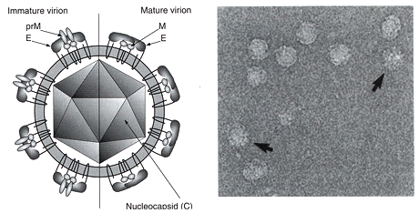
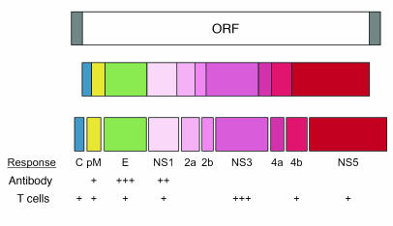
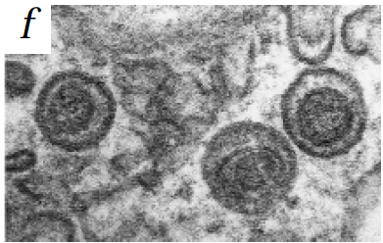
Rothman, 2004
virustaxonomyonline.org
Wu, et al, 2000
Dengue Virus
Flaviviridae: West Nile Virus, Japanese Encephalitis Virus
Enveloped, 40-60nm diameter
Single-stranded +sense RNA virus, single ORF, polyprotein cleavage
3 structural, 7 non-structural proteins
Four serotypes, antigenically distinct
Notes:
Ns1,ns4: replication cofactors; ns2, uknown; ns3, protease/helicase; ns5, rdrp/methyltransferase
Open reading frame (ORF) – coding sequence of a gene that would give rise to the protein product
Having an RNA genome means that the genetic material can immediately be translated to protein upon release into the host cell cytoplasm (DNA-RNA-protein, central dogma of genetics).

Slide 3
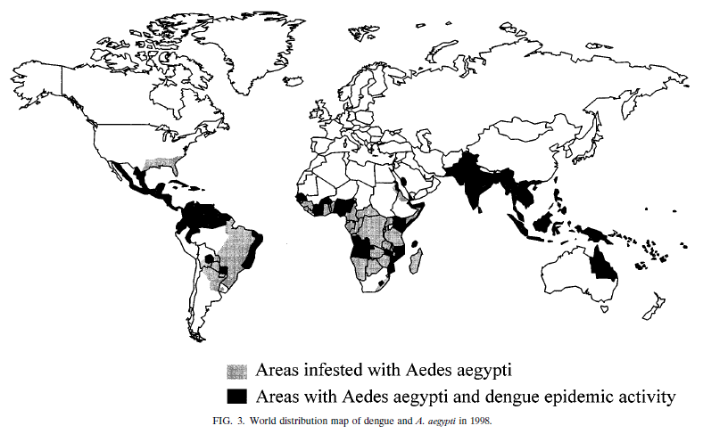
First reported DHF epidemic – Manila, 1953
Gubler, 1998
DENGUE HEMORRHAGIC FEVER
5-10% of reported cases
30-40% of hospitalized DHF patients progress to DSS
~500,000 cases annually (WHO estimate)
5% case-fatality rate
PDVI, 2006
Notes:
Seasonality: above equator july – september; below equator, november-february

Slide 4
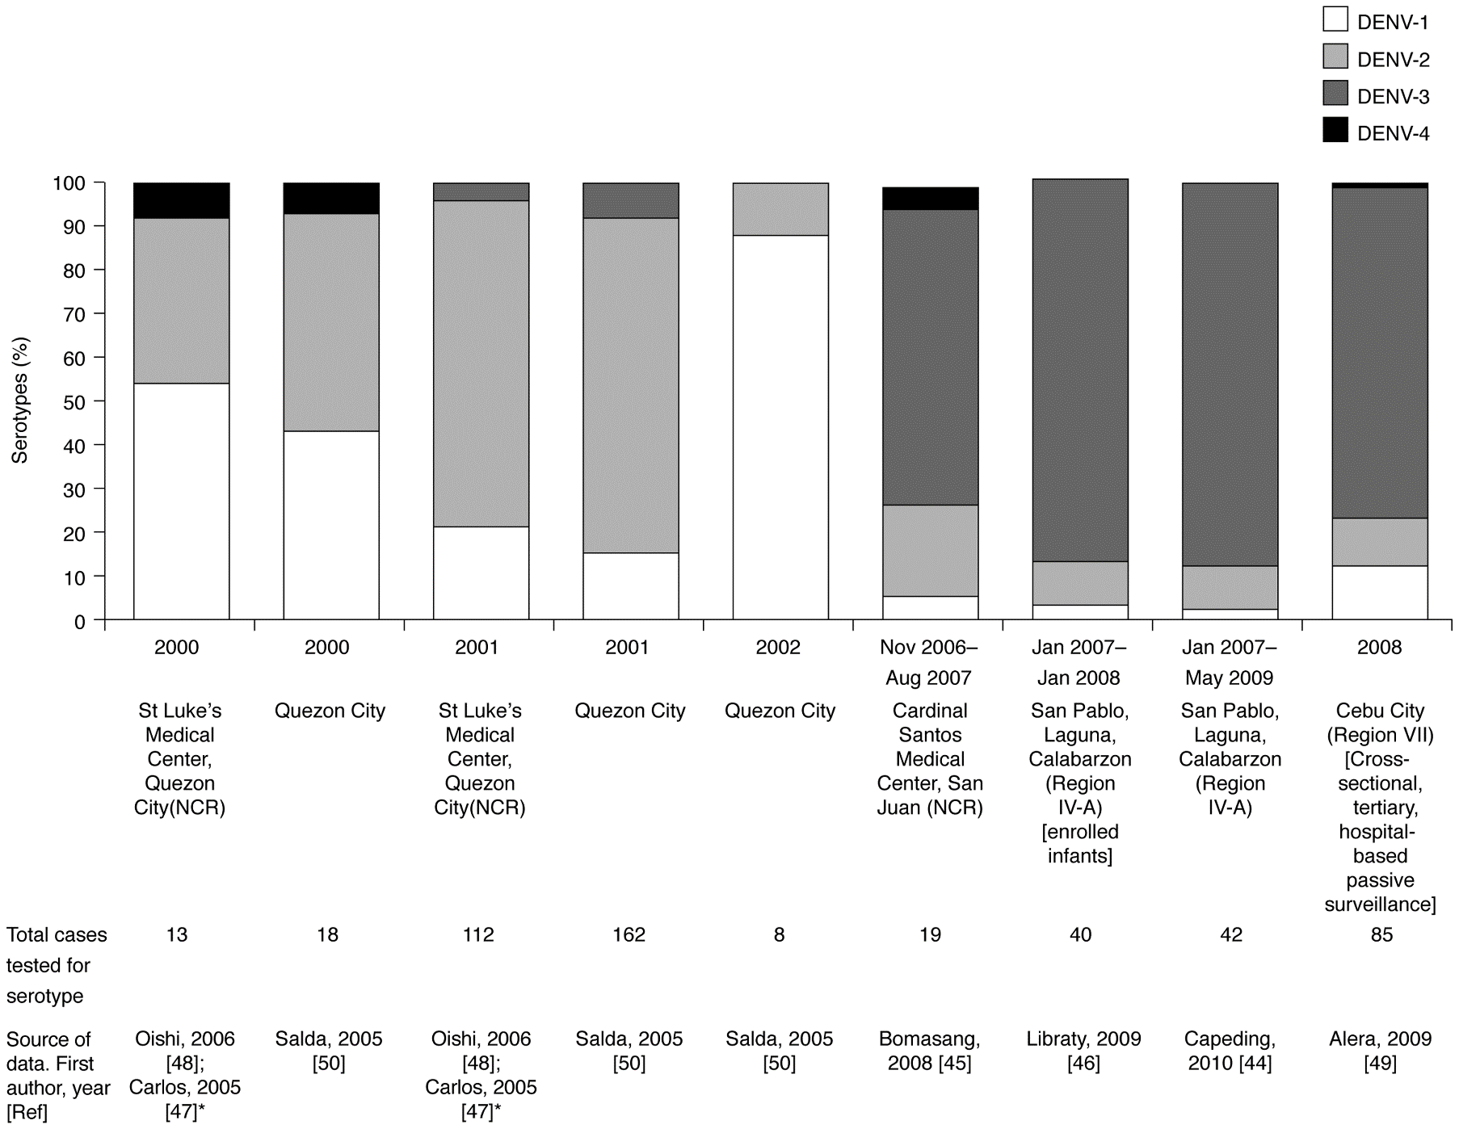
Epidemiology of Dengue in the Philippines
Bravo et al. PLoS Neg. Trop. Dis. 2014

Slide 5
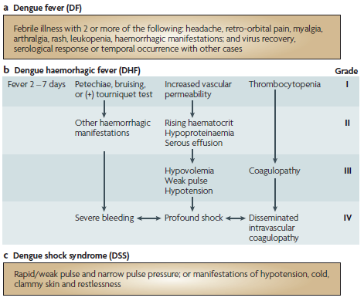
Pathology of DF/DHF/DSS
Dengue infection manifests clinically through a spectrum of symptoms:
Primary Infection can be asymptomatic, but commonly leads to self-limiting DF, or to low-grade DHF in rare cases
Secondary Infection usually progresses to DHF or DSS ; has higher viral loads and higher IgM titers
Whitehead et al., 2007
Notes:
WHO guidelines for classification of dengue fever; knowing the extent of disease is paramount for determining proper patient treatment and management

Slide 6
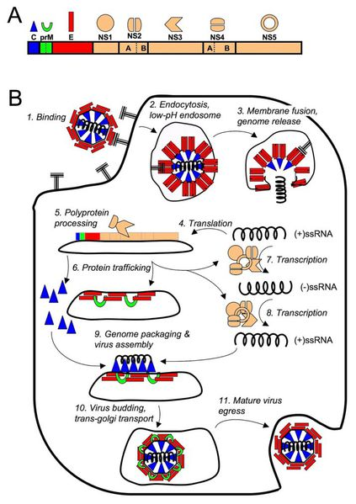
DENV (+)ssRNA genome
Schematic of viral
replication within
host cell
https://microbewiki.kenyon.edu/index.php/Effects_of_Pathogen-Vector_Interactions_on_the_Transmission_of_Dengue_Virus
Slide Credit: Dr. Aguda

Slide 7
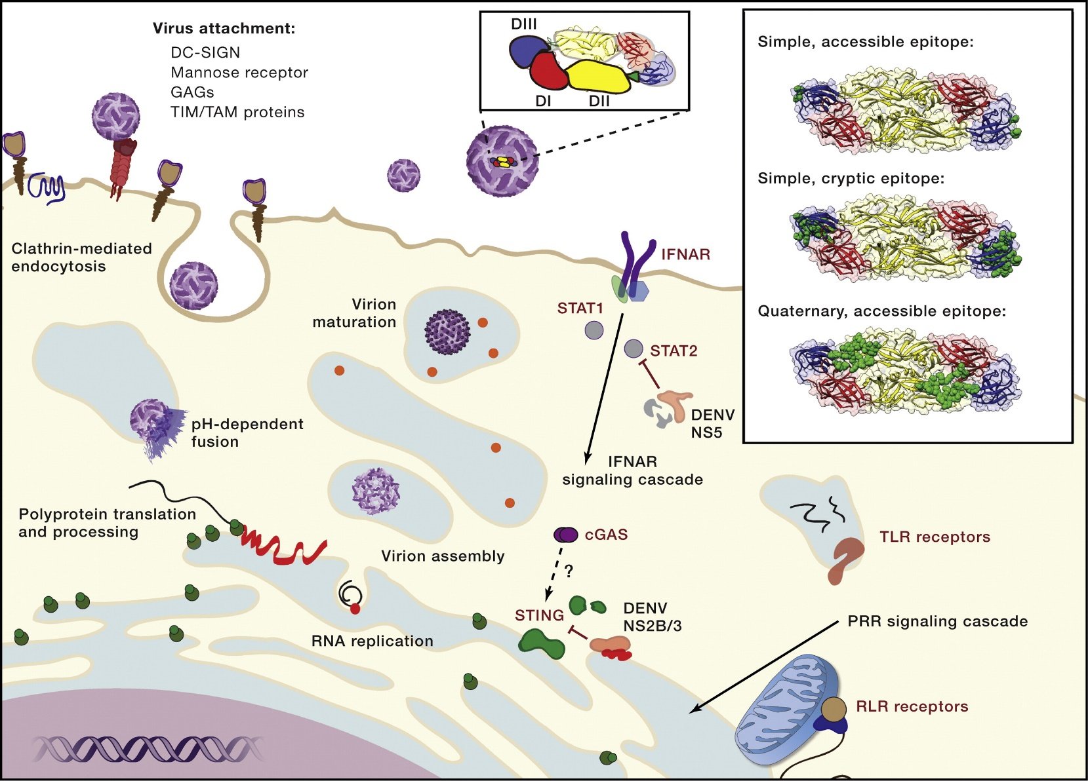
DENV Infecting a (Host) Cell
Molecular Insight into Dengue Virus Pathogenesis and Its Implications for Disease Control.
Diamond MS, Pierson TC. Cell. 2015 Jul 30;162(3):488-92.
Slide Credit: Dr. Aguda
Notes:
Cell Biology of DENV Infection
DENV interacts with target cells via one or more host factors that enhance attachment. DENV subsequently is internalized by endocytosis and fuses with membranes of the late endosome in a pH-dependent manner. Virus binding and membrane fusion are orchestrated by the envelope (E) protein, which is composed of three domains (top center, DI, shown in red; DII, shown in yellow; and DIII, shown in blue). Viral RNA translation and replication occur in association with membranes of the endoplasmic reticulum (ER). Newly synthesized viral RNA is packaged into immature virions, which bud into the ER lumen. During egress, the virion undergoes a maturation step defined by cleavage of the prM protein by furin proteases (orange spheres). DENV infection is detected by host pattern recognition receptors that selectively bind viral RNA molecules, including TLRs and RIG-I-like receptors (RLRs). Additionally, DENV infection activates the DNA sensor cGAS and STING pathway via unknown mechanisms. These cell-intrinsic host defense systems stimulate the production of IFNs to promote expression of antiviral ISGs. DENV has evolved mechanisms, including the NS2B/3-mediated cleavage of STING and NS5-mediated degradation of STAT2, to antagonize antiviral pathways. (Inset) An increasingly detailed understanding of the structural basis of antibody recognition has emerged. Antibodies have been characterized that bind epitopes (in green) on the virion comprised of a single or multiple E proteins. For example, the DIII lateral ridge epitope is contained within a single E protein (top), whereas the E-dimer-dependent quaternary epitope is composed of residues of both E proteins in the anti-parallel dimer (bottom). In contrast, other mAbs bind epitopes not predicted to be accessible using existing models of virion structure (middle).

Slide 8
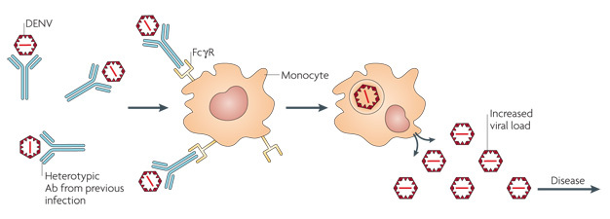
2. Severe Dengue Disease
Antibody-Dependent Enhancement (ADE)
Antibody (Ab)-dependent enhancement (ADE) of infection occurs when preexisting antibodies present in the body from a primary (first) dengue virus (DENV) infection bind to an infecting DENV particle during a subsequent infection with a different dengue serotype. The antibodies from the primary infection cannot neutralize the virus. Instead, the Ab–virus complex attaches to receptors called Fcγ receptors (FcγR) on circulating monocytes. The antibodies help the virus infect monocytes more efficiently. The outcome is an increase in the overall replication of the virus and a higher risk of severe dengue.
© 2007 Nature Publishing Group Whitehead, S. S. et al. Prospects for a dengue virus vaccine. Nature Reviews Microbiology 5, 518–528 (2007).
Slide Credit: Dr. Aguda

Slide 9
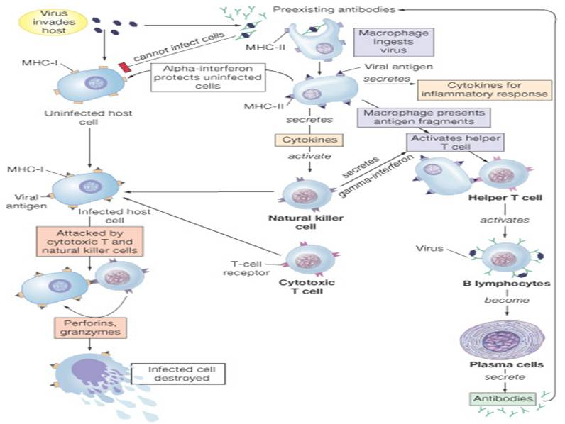
http://www.austincc.edu/apreview/PhysText/Immuno.html

Slide 10
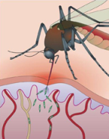
DF, 1° infection Pathogenesis
Martina et al., 2009 and references therein
Subcutaneus injection
Aedes aegypti
Langerhans cells, keratinocytes
infection
Regional
nodes
Lymphocytes Macrophages
Dendritic cells
infection
replication
Lymphatics
Thoracic duct
Budding: DV, NS1
T-cell activation
Ag presentation
Released to serum
Kupffer cells
Hepatic endothelium
infection
Liver
Spleen
Ag presentation
clearance
Clonal expansion
Neutralizing Abs
Bloodstream
Viremia
IgG immunity
(neutralizing/non-neutralizing)
IgM, complement clerance
Cell-mediated immunity
Class
switching

Slide 11
DF, 1° infection Pathogenesis
Martina et al., 2009 and references therein
DHF/DSS,
2° infection
Subcutaneus injection
Aedes aegypti
Langerhans cells, keratinocytes
infection
ADE:FcγR
Regional
nodes
Lymphocytes Macrophages
Dendritic cells
infection
replication
Cross-reactive epitopes on EC, platelets;
NS1 binding to non-infected cells
Preferential binding to GAG+ cells in liver, lungs
Increased viral titer in serum;
Inceased NS1 levels
Lymphatics
Thoracic duct
Budding: DV, NS1
T-cell activation
Ag presentation
Non-neutralizing Ab
Sub-neutralizing [ ]
Released to serum
Kupffer cells
Hepatic endothelium
infection
Liver
Spleen
Ag presentation
clearance
Pro-inflammatory cytokines;
EC, platelet dysfunction
=pleural,peritoneal effusion
Clonal expansion
Neutralizing Abs
Bloodstream
NS1, NS3
Viremia
IgG immunity
(neutralizing/non-neutralizing)
IgM, complement clerance
Cell-mediated immunity
Class
switching
Original Antigenic Sin

Slide 12
Open questions on Dengue
What really contributes to severe hemorrhagic disease in the course of dengue infection?
What are the determining factors for “tipping over” from DHF to DSS?

Slide 13
The role of antibody-dependent enhancement (ADE)
Non-neutralizing antibodies / sub-neutralizing Ab conc
180 copies, 90 dimers, 30 “rafts”
Icosahedral symmetry
Modis et al., 2004

Slide 14
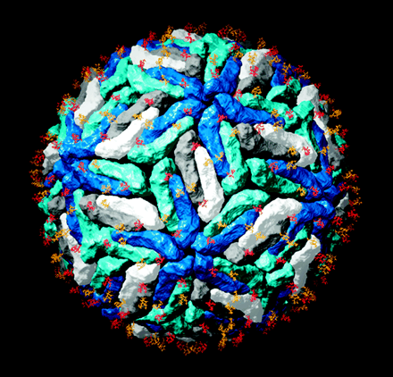
ADE Mechanism…
E protein is a glycoprotein
Epitope-mapped (neutralizing) antibodies attach to viral surface at 120 copies (full occupancy)
These inhibit E-protein rearrangement for membrane fusion = blocks viral entry
Can act on pre-attachment or post-attachment particles
Rey F. PNAS. 2003
Fibriansah G, et al. EMBO Mol. Med. 2014

Slide 15
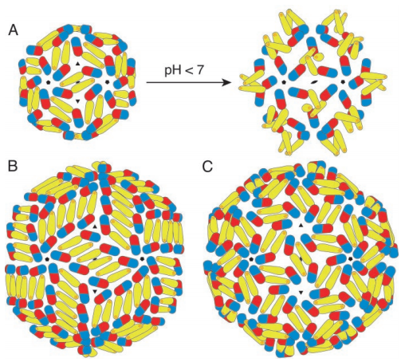
ADE Mechanism…
Y
Y
Y
Y
Y
Y
Y
Y
Y
X
Y
Y
Y
Y
Y
Y
Y
Y
Non-neutralizing Abs: different epitope
Sub-neutralizing Abs: insufficient [ ] or high dissociation rate
Modis et al. PNAS. 2003

Slide 16
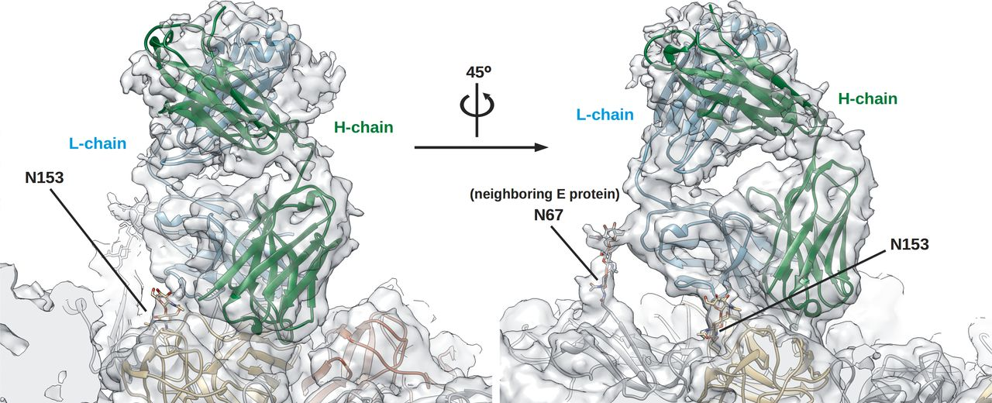
DENV Epitopes
Surface shape complementarity to Abs
Physicochemical interactions: inter-amino acid interactions (hydrophobic, polar, electrostatic, VDW)

Slide 17
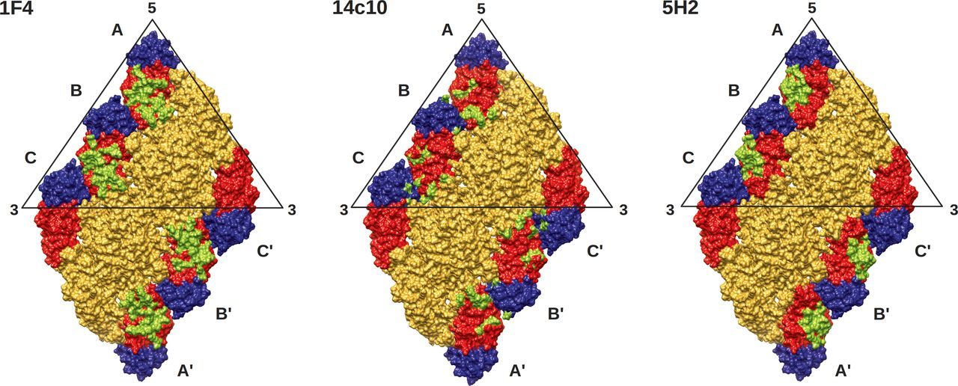
DENV epitopes
Most Abs in 1° infection are non-neutralizing and/or cross-reactive
Epitope recognition is a random process
Host pool of B-cells
Location of “first contact” with virus (can be anywhere on viral surface)
Immunodominant epitopes (strong affinity/avidity)
Quasispecies
Mab 1F4 interaction with E protein epitope mostly polar, involving H-bonds and salt bridges in the vicinity of the fusion loop between DI and DII (of neighbor dimer).
Most epitopes are quaternary / discontinuous
Some escape mutants of 1F4 involve opposite charge mutations (K47E, G274E) resulting in loss/reduced of antibody binding
Fibriansah G, et al. EMBO Mol. Med. 2014

Slide 18
Dengue Infection Timeline

Slide 19
Immunoglobulin properties
Species | Immunoglobulin | Serum Level (mg/mL) | Molecular Mass (kD) | Activation/Binding of Complement | Half-life (days)
Human | IgA1 | 0.6 - 3 | 160 (monomer) | - | 5.5
Human | IgA2 | 0.06 - 0.6 | 160 (monomer) | - | 5.5
Human | IgM | 1.5 | 970 (pentamer) | +++ | 5-10
Human | IgE | 5 x 10⁻⁵ | 188 | - | 2
Human | IgG1 | 3.8 - 11.4 | 146 | ++ | 23
Human | IgG2 | 1.5 - 6.9 | 146 | + | 23
Human | IgG3 | 0.2 - 1.7 | 165 | +++ | 7
Human | IgG4 | 0.08 - 1.4 | 146 | - | 23
+++ = Very Strong Affinity; ++ = Strong affinity; + = Moderate affinity; - = No affinity
http://www.ebioscience.com/knowledge-center/antigen/immunoglobulin.htm

Slide 20
NS1 and Pathogenesis
Role of NS1 in immunopathogenesis
NS1 binding to GAGs can activate host cell.
Bound NS1 on cell surface can attract Abs, activate complement and mediate bystander cell damage
NS1 has an immunodominant cross-reactive epitope to integrins (KLE motifs), eliciting autoimmune Abs. autoAbs binding to cellular integrins can cause cell activation (release of factors or death: EC, platelets, fibrinogen).
Y
Y
ELK/KLE integrin motif
NS1
HS/CS binding site
Y
Y
Y
Host cells
GAGs: heparan sulfate (HS) / chondroitin sulfate (CS)
Falconar AK. Clin. Vaccine Immunol. 2007

Slide 21
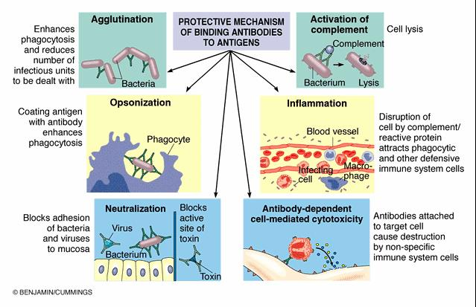
http://www.austincc.edu/apreview/PhysText/Immuno.html

Slide 22
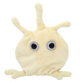
Integrated pathogenesis
Y
Y
Y
Y
T-cells
B-cells
Thrombocytopenia
mNS1
ADE
Y
Y
Y
Y
Y
U
Y
Y
Y
*
*
Typical infection
Ag presentation
*
sNS1
Platelets
Viral particles
Complement
Host cell death (apopotosis)
Viral clearance
Cytokine release
Y
Y
Y
Y
Important: Ig class and subclass
(ability to fix complement,
multimer formation, etc)
Endothelial cells
Vascular leakage
(DHF)
EC Activation (cytokines)
Bystander damage
Apoptosis
DSS
Prolonged cytokine storm
Hypovolemic shock threshold (?)

Slide 23
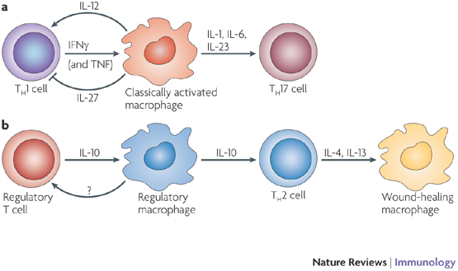
What to do next
For each cell affected in dengue infection (direct targets, immune modulators)
Gather receptors, signal transduction pathways and cytokine profile
Model network topology
Model network flux/dynamics (if possible)
Verify NS1 cross-reactive autoimmune antibodies to platelets/ECs
Quantify NS1-specific Abs (1,2) and autoimmune Abs (ratio)
DHF/DSS animal model / patient cohort
Mosser and Eduards. Nat Rev Immunol. 2008

Slide 24
Thank you!
Happy Holidays and Enjoy the Christmas break ☺

Slide 25
Viral factors
E protein
Cell receptors
Humoral cross-reactivity (ADE)
NS1
Autoimmune reactions (anti-DEN Ab cross-reactivity to host)
Infected & non-infected cells
Membrane bound vs soluble
Soluble form re-attachment to non-infected cells
Endothelial cells, monocytes, macrophages...
Complement activation, MAC inhibition
AB recognition on cell surfaces
Endothelial cell activation, dysfunction
Platelet activation, dysfunction
NS3
Cross-reactive t-cell epitopes
Original antigenic sin

Slide 26
Host Factors
HLA- and non-HLA associated polymorphisms involved in the development of DHF/DSS:
FcyRIIa, TNF-a, DC-SIGN, HLA - I, HLA - II
** Development of DHF/DSS:
Intrinsic virulence of serotype vs. Host predisposition and timing+combination of factors that lead to plasma leakage (ala activation energy)

Slide 27
Role of Cytokines and Complement
Cytokines mediate (inhibit/promote) inflammatory processes brought about by cellular immunity
Preferential activation of pro-inflammatory factors facilitate EC dysfunction
Cytokines upregulated during infection:
IL-1, IL-6, IL-8, IL-10, TNF-a, TGF-b
In DHF/DSS, Th1 first, then switchover to Th2 in later stages / prior to vascular leakage
Other factors:
Activation of thrombin, nitric oxide (NO), C3a and C4b
Martina et al., 2009

Slide 28
NS1 (non-structural protein 1)
45 kDA glycoprotein
Exists as both intracellular and extracellular forms: found as a dimer associated with the membrane of infected cells and as a soluble hexamer in the acute phase sera of infected patients (Young et al. 2000)
NS1 can be detected in the serum even at 9 days after the onset of fever. NS1 can be detected even when viral RNA is negative at RT-PCR or in the presence of IgM antibodies (Alcon et al. 2002)

Slide 29
NS1 (non-structural protein 1)
NS1 is a marker of disease severity. Patients with DHF/DSS have high levels of NS1 in the serum (Avitrunan et al. 2006)
NS1 antigen and anti-NS1 antibodies can be used to differentiate between the 4 dengue serotypes (Shu et al. 2003)

